Slide 1

Beyond Syntax: Teaching Problem-Solving in R and Python through Real-Life Coding Challenges DEE2025 Conference
Github page for this workshop
Ralf Becker (University of Manchester) Yichen Zhu (Aston University)
https://datasquad.github.io/DEE2025_coding/

Slide 3
Agenda
Workshop Objectives
Why This Workshop?
“Getting your hands dirty” Instruction
Interactive Worksheet
Evaluation Evidence (Case Study: Aston, Manchester)
Group Reflection
Wrap-up & Takeaways
Github page for this workshop
https://datasquad.github.io/DEE2025_coding/

Slide 4
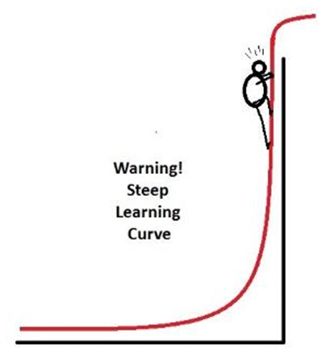

Why This Workshop?
Steep learning curve for beginners, particularly in grasping coding logic and syntax.
Need to foster independent coding and problem-solving skills.
How to adjust instruction in the presence of AI?
Shift focus:
From memorising syntax → to understanding coding processes
From “knowing the right code” → to engaging actively with coding challenges
From avoiding resources → to using web searches and LLMs productively

Slide 5

What Changes Because of AI?
Debate in the Computer Science (CS) pedagogy literature (e.g. Prather et al, 2023, for a review) on how to change CS education:
Increased focus on being able to read code (rather than write)
Increased focus on structuring through a problem
Consequences for assessment (not really discussed here)

Slide 6








“Getting your hands dirty” Instruction
We think that the way we instruct students should reflect the way they will have to work on data after they leave our course.
Examples of typical real-life coding tasks:
None of the typical activity involves being given a complete and correct code file.
Package Management
Interpreting Errors
Debugging
Using AI
Using Documentation
Using the Internet
Data Cleaning
Struggling

Slide 7
“Getting your hands dirty” Worksheet
We want to design worksheets that incorporate these activities.
Setting:
Worksheets for students to complete independently, or
Worksheets for students to tackle during a computer lab
These worksheets will have the following components:
Scaffolded problem-solving using fill-in-the-blank exercises
Find solutions by consulting documentation or the internet
LLM-enhanced exploration
Active recall and feedback via MCQs and instant feedback
Progress from guided to independent tasks, scaffolding
Intentional bugs and debugging activities

Slide 8


Implementation
In R: We use Rmarkdown, and in particular the Webexercises (Dale Barr and Lisa DeBruine) template/package to implement the interactive elements
In Python: We write jupyter notebooks using functionality of the pretty jupyter package (Jan Palasek)
Both produce HTML documents with interactive elements. Here we will provide templates for both.

Slide 9
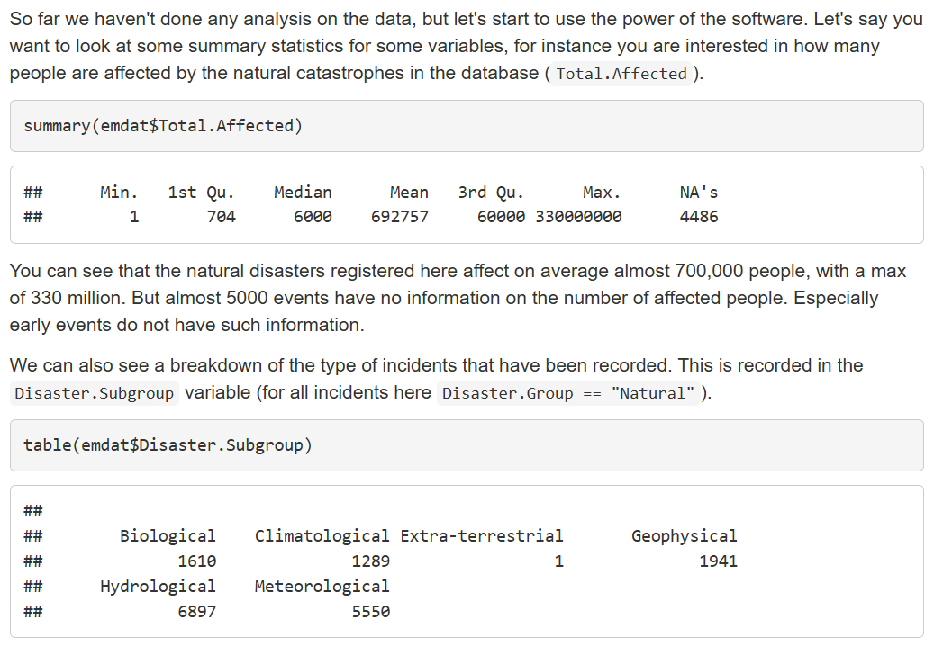
Rmarkdown Documents
Combines
Text
Code
Output (could be plots)
Also:
Straightforward LaTeX integration
Flexible control of whether you wish to show code and/or output
This is an HTML file which you share with students. They can download it and work on it locally (also offline). Or you host it on a website, e.g. a GitHub page.

Slide 10
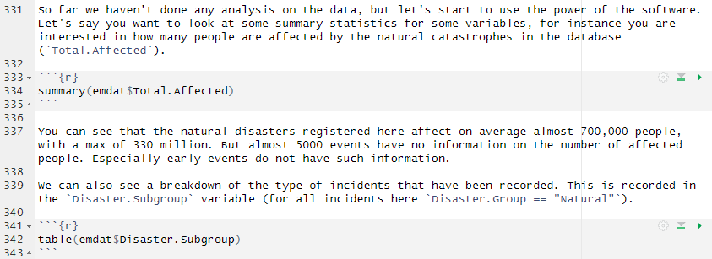
Rmarkdown Documents
R Markdown File
HTML Output
The Rmarkdown code
Code is enclosed in:
You can control whether code shows, executes, messages and errors are shown and how code output is shown
```{r}
YOUR CODE GOES HERE
```
To get from Rmarkdown to HTML you need to render or knit the file (done through Rstudio)

Slide 11
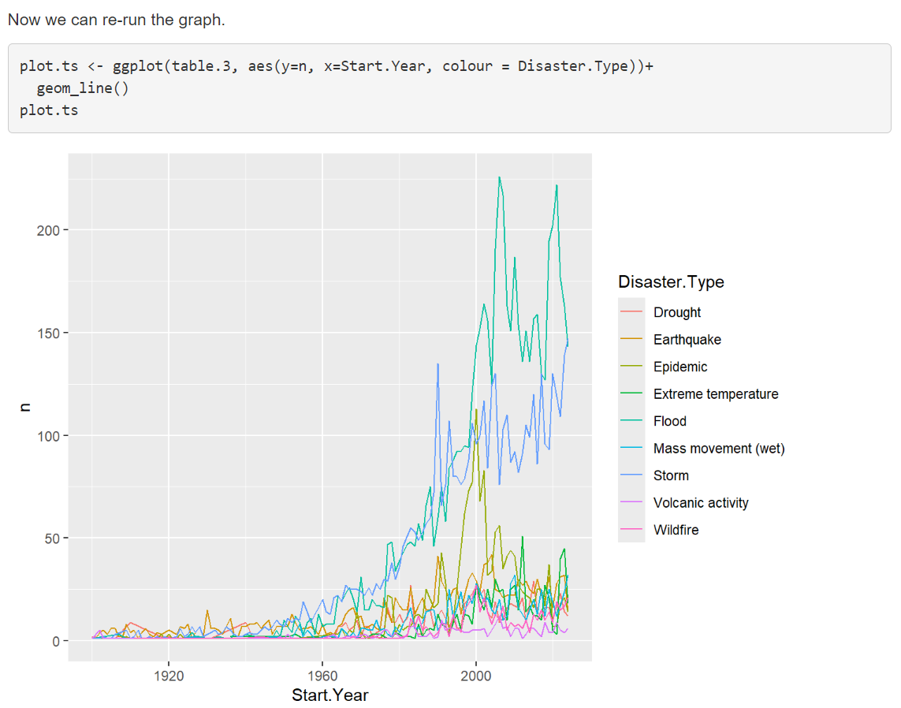
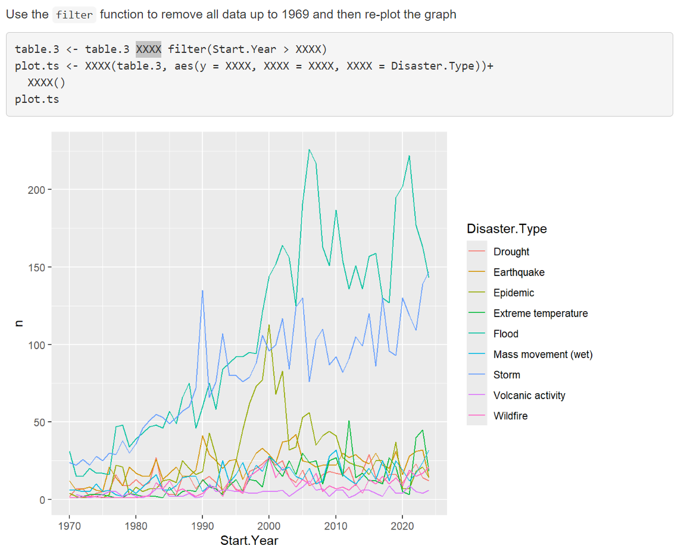
Rmarkdown Interactive Elements
Scaffolding and fill in the blank
Incomplete code, XXXX represents blank

Slide 12
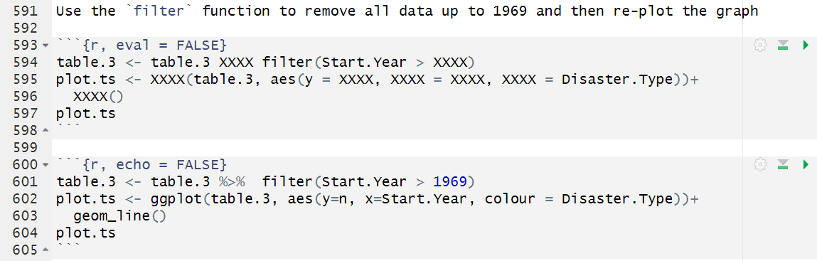
Rmarkdown Interactive Elements
Scaffolding and fill in the blank
R Markdown File
HTML Output
eval (= TRUE is default) and echo (=TRUE) control whether code is executed and shown respectively
The incomplete code is shown but not executed (eval = FALSE).
The correct code is executed but not shown (echo = FALSE)
Ensure learners can check that they got the right result (here replicate the plot)

Slide 13
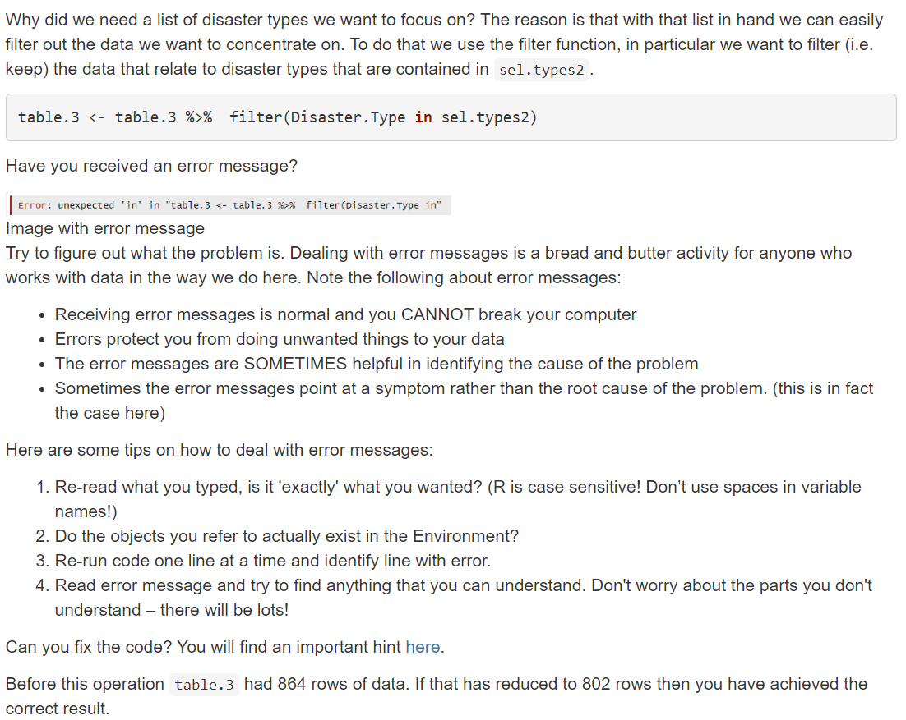
Rmarkdown Interactive Elements
Intentional error and guidance on rectifying error

Slide 14
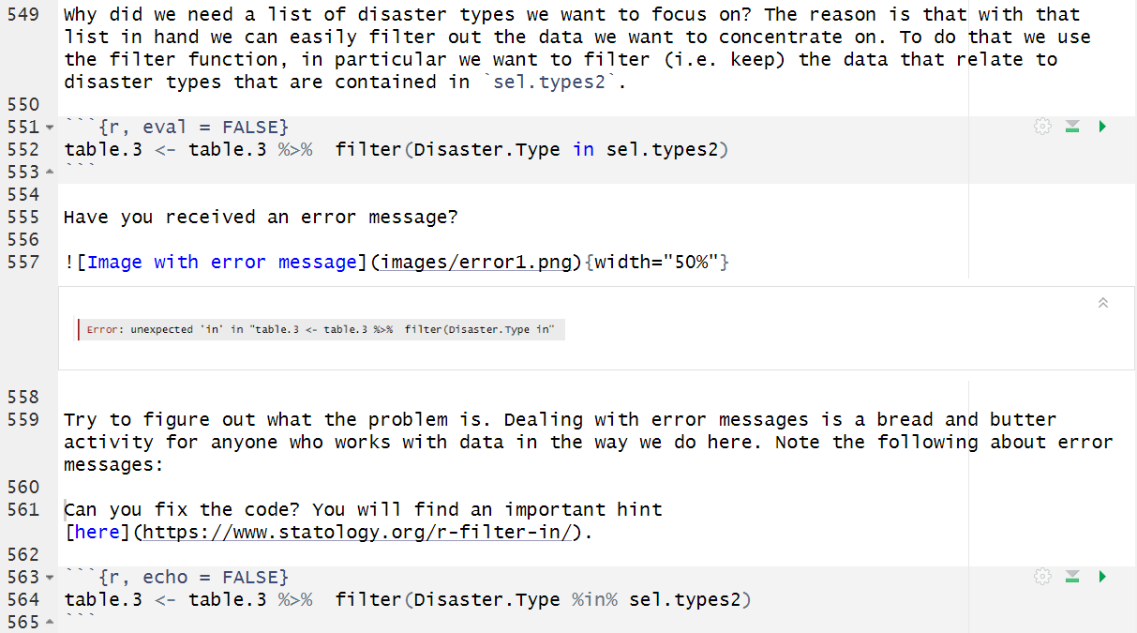
Rmarkdown Interactive Elements
Intentional error and guidance on rectifying error
R Markdown File
HTML Output

Slide 15
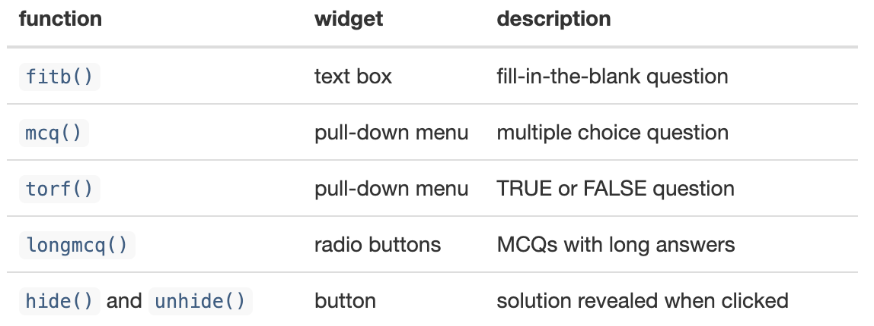
Webexercises Additional Functionality
Types of Interactive Exercises You Can Create with Webexercises Package
The Webexercises package provides functions that create HTML widgets using inline R code. These functions are:
This workshop will focus on the design and application of fitb(), longmcq(), hide() and unhide().

Slide 16
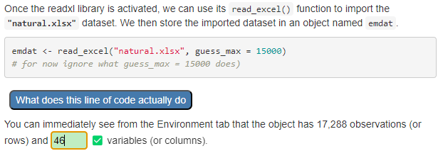
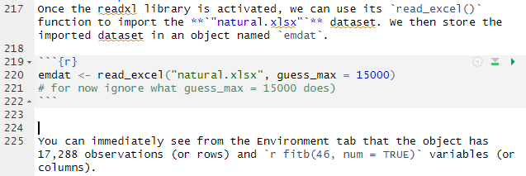

Webexercises Additional Functionality
fitb()
Fill-in-the-blank question: Testing understanding of code and data structures
HTML Output
R Markdown File
The fitb() functionality also allows for a discrete list of correct text responses and numerical responses with a predetermined amount of tolerance

Slide 17
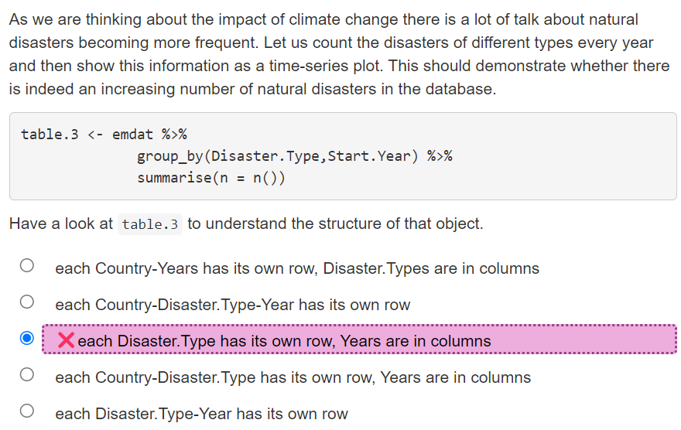
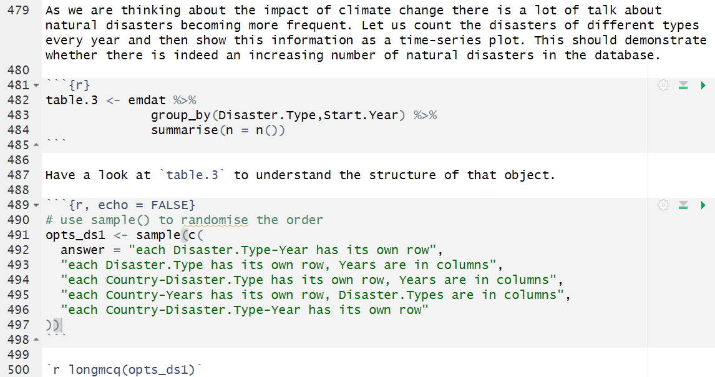

Webexercises Additional Functionality
longmcq()Multiple choice question with long answers: Testing understanding of code and data structures
HTML Output
R Markdown File

Slide 18
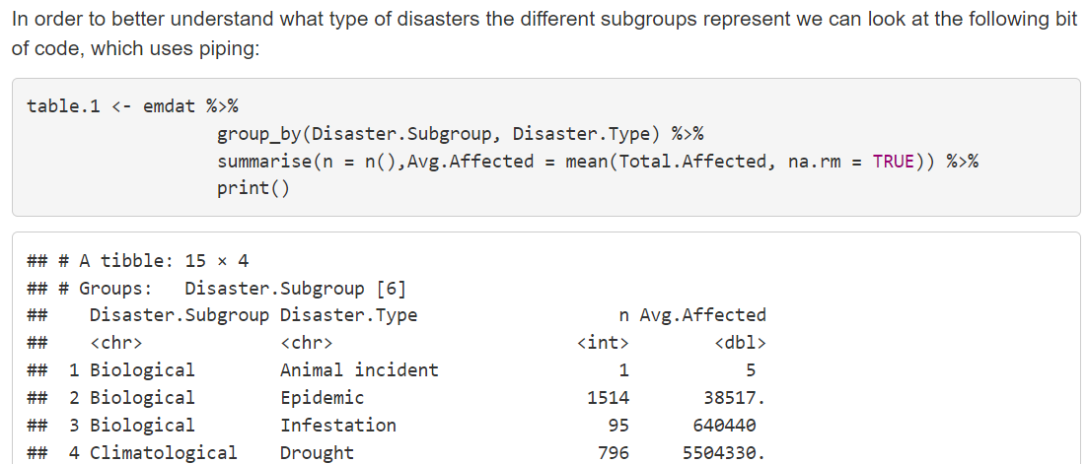
Webexercises Additional Functionality
hide() and unhide()
Solution revealed when clicked: Support code reading/understanding and using ChatGPT

Slide 19
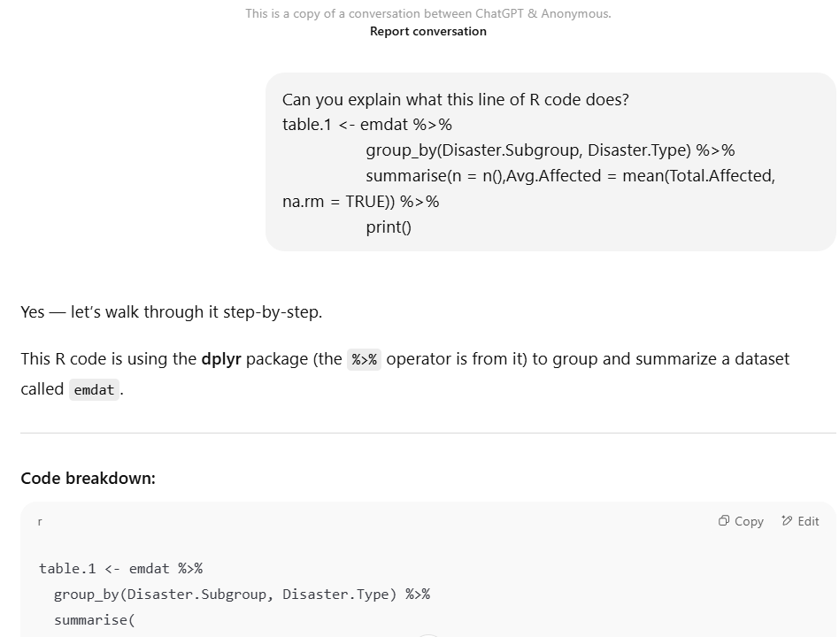
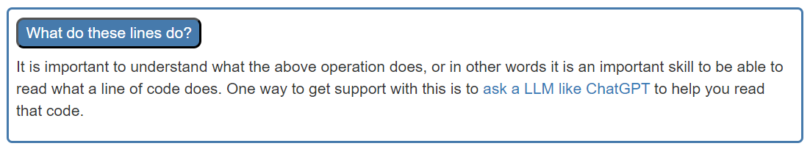
Webexercises Additional Functionality
hide() and unhide()
Solution revealed when clicked: Support code reading/understanding and using ChatGPT
Saved and linked ChatGPT conversation

Slide 20
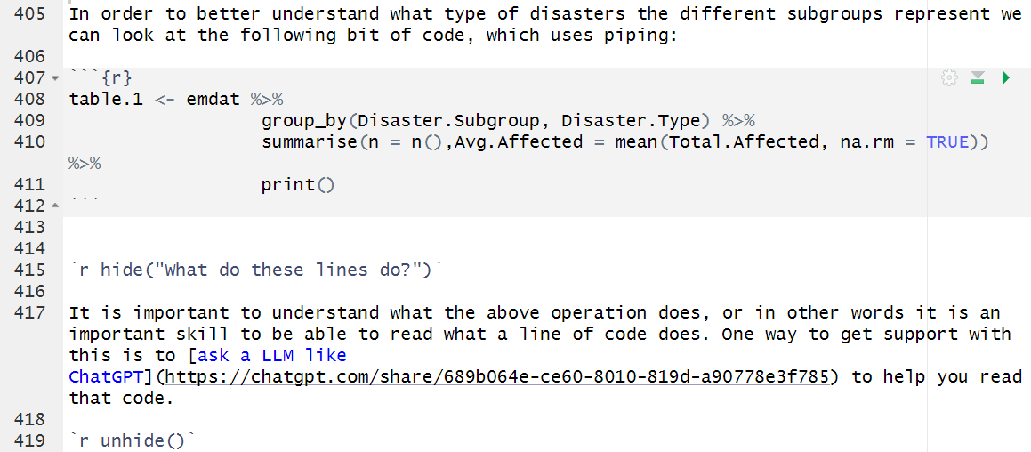


Webexercises Additional Functionality
hide() and unhide()
Solution revealed when clicked: Support code reading/understanding and using ChatGPT
HTML Output
R Markdown File
hide() and unhide() create the clickable box
‘What do these lines do?’

Slide 21
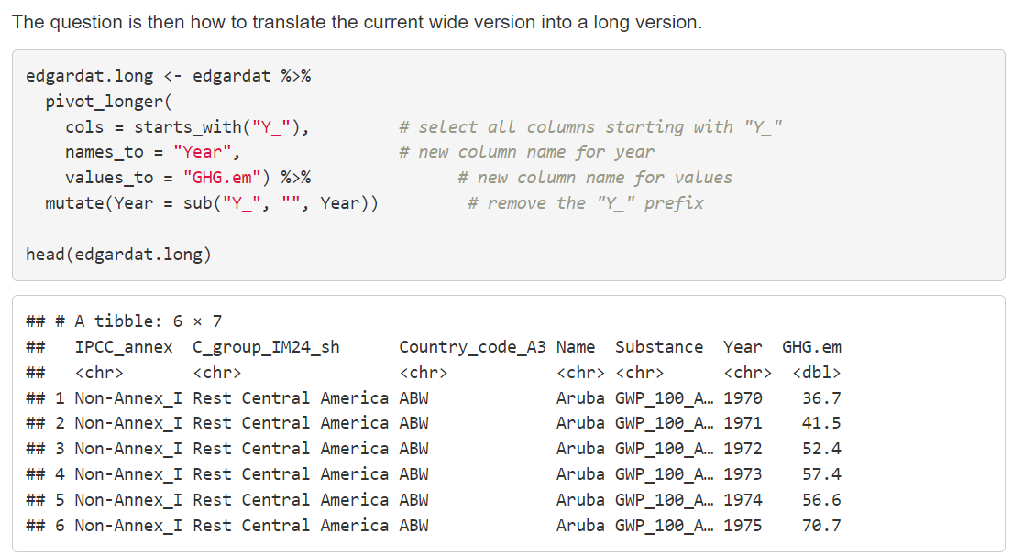
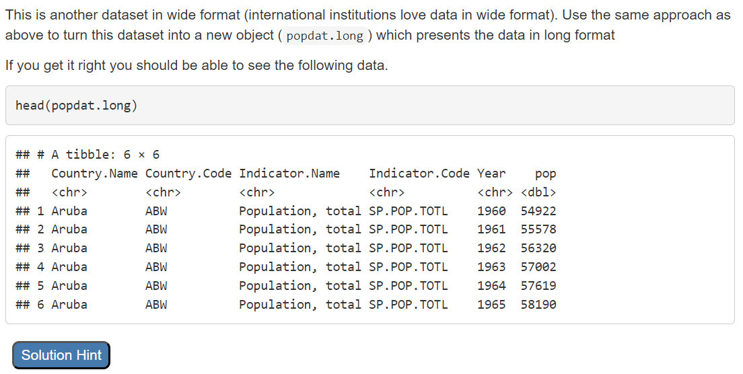
Webexercises Additional Functionality
hide() and unhide()
Even more…: Multi-level scaffolding
Show the correct code directly: convert data from wide to long
A little later … same problem, no code

Slide 22
Webexercises Additional Functionality
hide() and unhide()
Even more…: Multi-level scaffolding

Slide 23
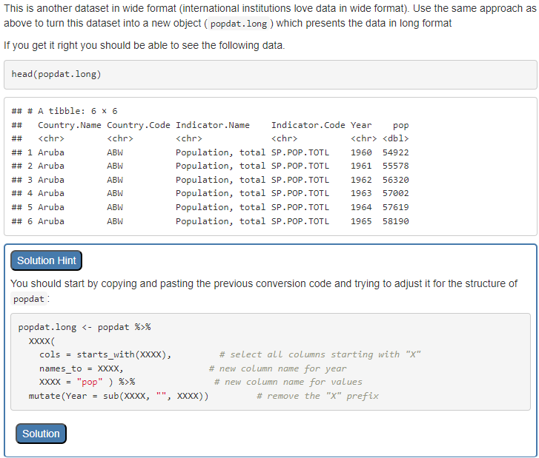
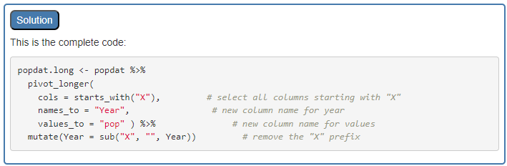
Webexercises Additional Functionality
hide() and unhide()
Even more…: Multi-level scaffolding

Slide 24
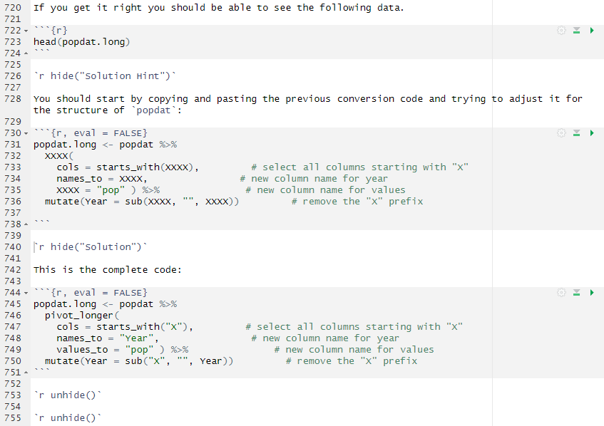
Webexercises Additional Functionality
hide() and unhide()
Even more…: Multi-level scaffolding
HTML Output
R Markdown File
Nested hidden boxes can create the multi-level scaffolding

Slide 25
Interactive Worksheet
Fully worked example
Setting: A first intro to working as an applied economist in R. Designed as a two-hour work through/demonstration.
Aim: Show how applied economists work and show some of the possibilities, not to teach particular techniques, rather to show working patterns
R in Rmarkdown, rendered: html (from Github),
datafiles are also available from here.
Github page for this workshop
https://datasquad.github.io/DEE2025_coding/

Slide 26
Interactive Worksheet
What You Need to Design It?
R & R studio
RStudio – for developing and testing your worksheets
Output
HTML output – to publish the worksheets as interactive documents
The webexercises package – to embed interactive components within R Markdown
R needs to be installed on your computer
Write R Markdown files – to structure worksheets
These can be shared as files through VLEs
Students can download these and work on them (also offline) but avoid using images, or
You can host them on a website (e.g. GitHub)

Slide 27
Jupyter Notebook
As above
Python in Jubyter Notebook, rendered: html (from Github)
datafiles are also available from here.
Github page for this workshop
https://datasquad.github.io/DEE2025_coding/

Slide 28
Interactive Worksheet
What You Need to Design It?
Python & VS Code (or other IDE)
VS Code – for developing and testing your worksheets
Output
HTML output – to publish the worksheets as interactive documents
The pretty jupyter package – to embed interactive components within Jupyter Notebook
Python needs to be installed on your computer
Write Jupyter Notebook files – to structure worksheets
These can be shared as files through VLEs
Students can download these and work on them (also offline) but avoid using images, or
You can host them on a website (e.g. GitHub)

Slide 29
Evaluation Evidence (Case Study: Aston University)
Module overview
Econometrics I, Y2 module at Aston University focusing on econometric principles and practical applications using R programming.
Student demographics
Approximately 210 students are enrolled annually, mixed levels of coding experience, the majority encountering R for the first time
Teaching Structure
R workshops are held bi-weekly, totalling 5 R workshops, app. 40 participants per group.
Assessment
500 words coursework (mid-term): Emphasis on descriptive statistics, plots and coding
1500 words coursework (end-term): Focus on regression analysis, interpretation and coding

Slide 30
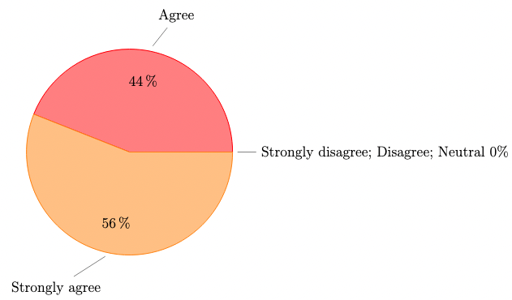
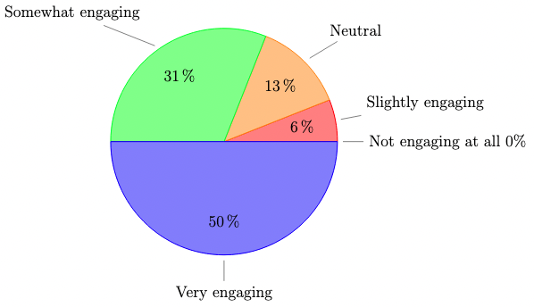
Evaluation Evidence (Case Study: Aston University)
To what extent do you agree that fill-in-the-blank worksheets in Econometrics I make it easier to understand R code logic and structure? | How engaging do you find the fill-in-the-blank worksheets in your econometrics module?
Note: Results are based on 32 survey participants.

Slide 31
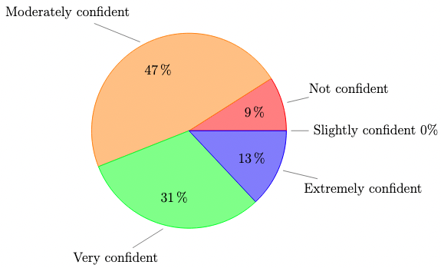
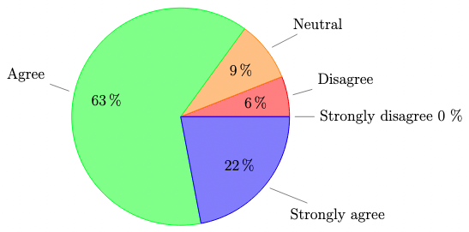
Evaluation Evidence (Case Study: Aston University)
To what extent do you agree that fill-in-the-blank worksheets in Econometrics I enhance your ability to solve coding problems independently? | How confident are you in applying skills from Econometrics I fill-in-the-blank worksheets to real-world data analysis?
Note: Results are based on 32 survey participants.

Slide 32
Evaluation Evidence (Case Study: Aston University)
What is going well in the fill-in-the-blank style R workshop?
1. Understanding and Clarity | “It is very easy to use and understand and keeps me engaged all the time to try and get the answer.” “It is easy to understand the code and the framework is provided.” “It provides examples on how the analysis is interpreted and applied in the correct format. Its interactivity is easy to understand.”
2.Problem-Solving and Critical Thinking | “It makes us put additional effort and think, not just copy and paste already ready codes.” “Understanding by doing it myself.” “It helps provide answers if I am stuck so that I can work out for myself why this answer is correct.”
3.Learning and Skill Development | “I think that it helps me to understand what I have to do in times when I don’t know where to start.” “Help with calculations of the example data given. Gives a good understanding of the use of each code.”
4. Engagement and Active Learning | We get to know the response immediately.” “You can easily see if your answers are correct or not.”

Slide 33
Evaluation Evidence (Case Study: Aston University)
The fill-in-the-blank style R workshop would be even better if …?
1. Learning and Engagement | “Maybe after filling in the blanks, there are some codes we have to do completely independently after.” “Include more examples.” “More possible answers as you could just try them all without being forced to learn.”
2. Format and Clarity | “That the answers weren’t directly exposed.” “There was less multiple choice as it made it easy to figure out.” “Better hints.”
3. Technical Issues | “The answers could save or be saved as a document to track progress.” “Sometimes rounding can be a problem.” “Sometimes filling in the blanks can have some issues when it comes to rounding.”

Slide 34
Complete Workthrough and Templates
DEE2025 Coding Github page
https://datasquad.github.io/DEE2025_coding/
Further Resources
Econometric Computing Learning Resource (ECLR) https://datasquad.github.io/ECLR/

Slide 35
Group Reflection
Discuss barriers, benefits, and possible modifications.
Share practical tips for integrating these strategies

Slide 36
Wrap-up & Takeaways
Summary of key points
Provide a link to GitHub/OneDrive folder with: Editable worksheet templates
Invitation to follow-up or collaborate

Slide 37
Literature
Prather J, et al. (2023), ITiCSE-WGR '23: Proceedings of the 2023 Working Group Reports on Innovation and Technology in Computer Science Education, 108 – 159, https://doi.org/10.1145/3623762.363349
Kyaw H.H.S, et al. (2021) A Study of Element Fill-in-Blank Problems for C Programming Learning Assistant System, International Journal of Information and Education Technology, 11, 255-261

